Slide 1
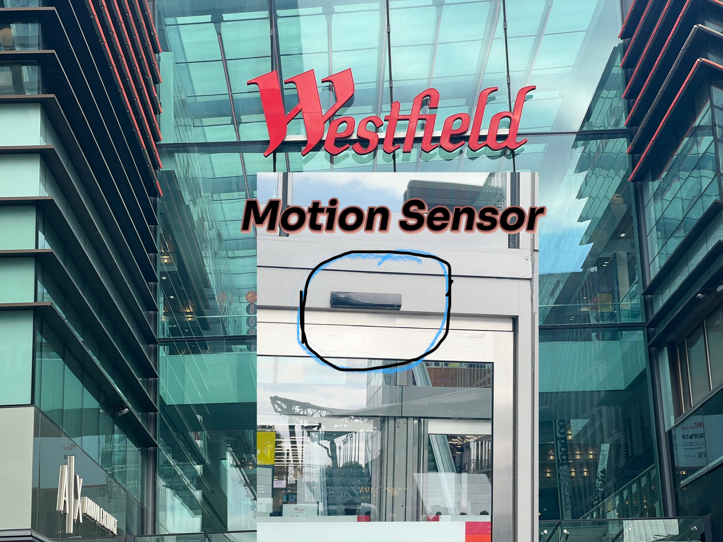
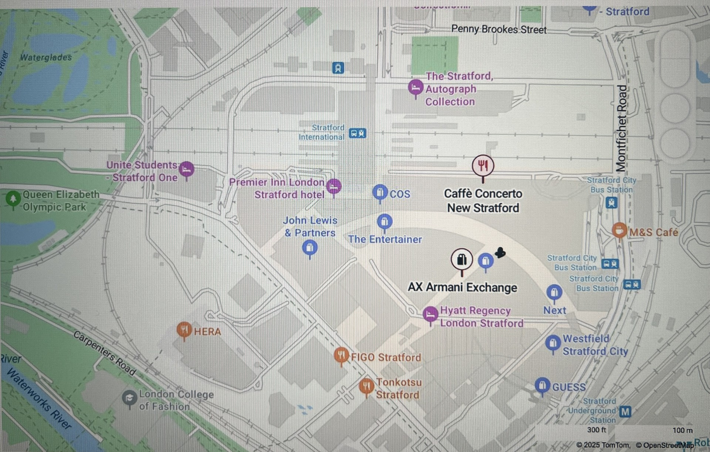
Motion Sensor
The black device above the glass door in the picture, located in Stratford Westfield shopping centre, is a motion sensor used to automatically open sliding doors and continuously scans the area below it .
When it detects movement or a change in infrared energy (from a person approaching), it sends a signal to the door’s control system. The doors then open automatically and close after a short delay when no motion is detected.
It provides hands-free access and improves accessibility and hygiene.
https://rutlanduk.co.uk/westfield-stratford-city-shopping-centre-ts-9205/
provide links to trusted websites that talks about the motion door sensors in westfield stratford
Questions when visiting site
Has this sensor ever had false activations or failures? If so, how are these issues handled?
Is this sensor/door system integrated with safety protocols like: in fire mode, lockdown mode, or for crowd control?
Location info:
Unit 101,Westfield Stratford City, Ground Floor, E20 1EP https://maps.app.goo.gl/KpkbJ7zc7h7Darar9
Submitted: Madina Diallo Oct 2025

